Slide 1
Website Security
Mark Bellingham

Slide 2
Why do we need website security?
Hacked websites can
Cause embarrassment
Prevent users from accessing content
Put users security at risk
Let people steal data
Be used to launch malicious software
  Email spam
  Be part of a botnet

Slide 3
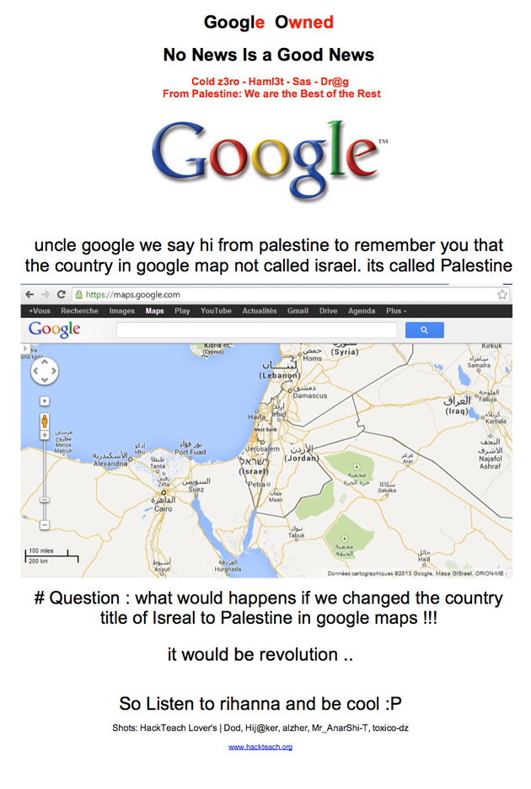
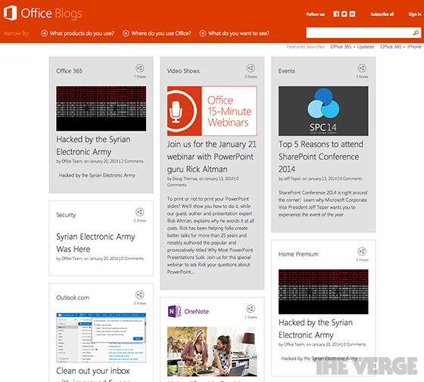
Examples of hacked websites

Slide 4
Good security principles
Problem of website hacking will always exist
No one single solution
Different layers each doing a small job well

Slide 5
Aims of the program
Download and hash source code
Monitor for changes
Identify users at time of change
Notify administrator
Restore website
Block repeat offenders (maybe)

Slide 6
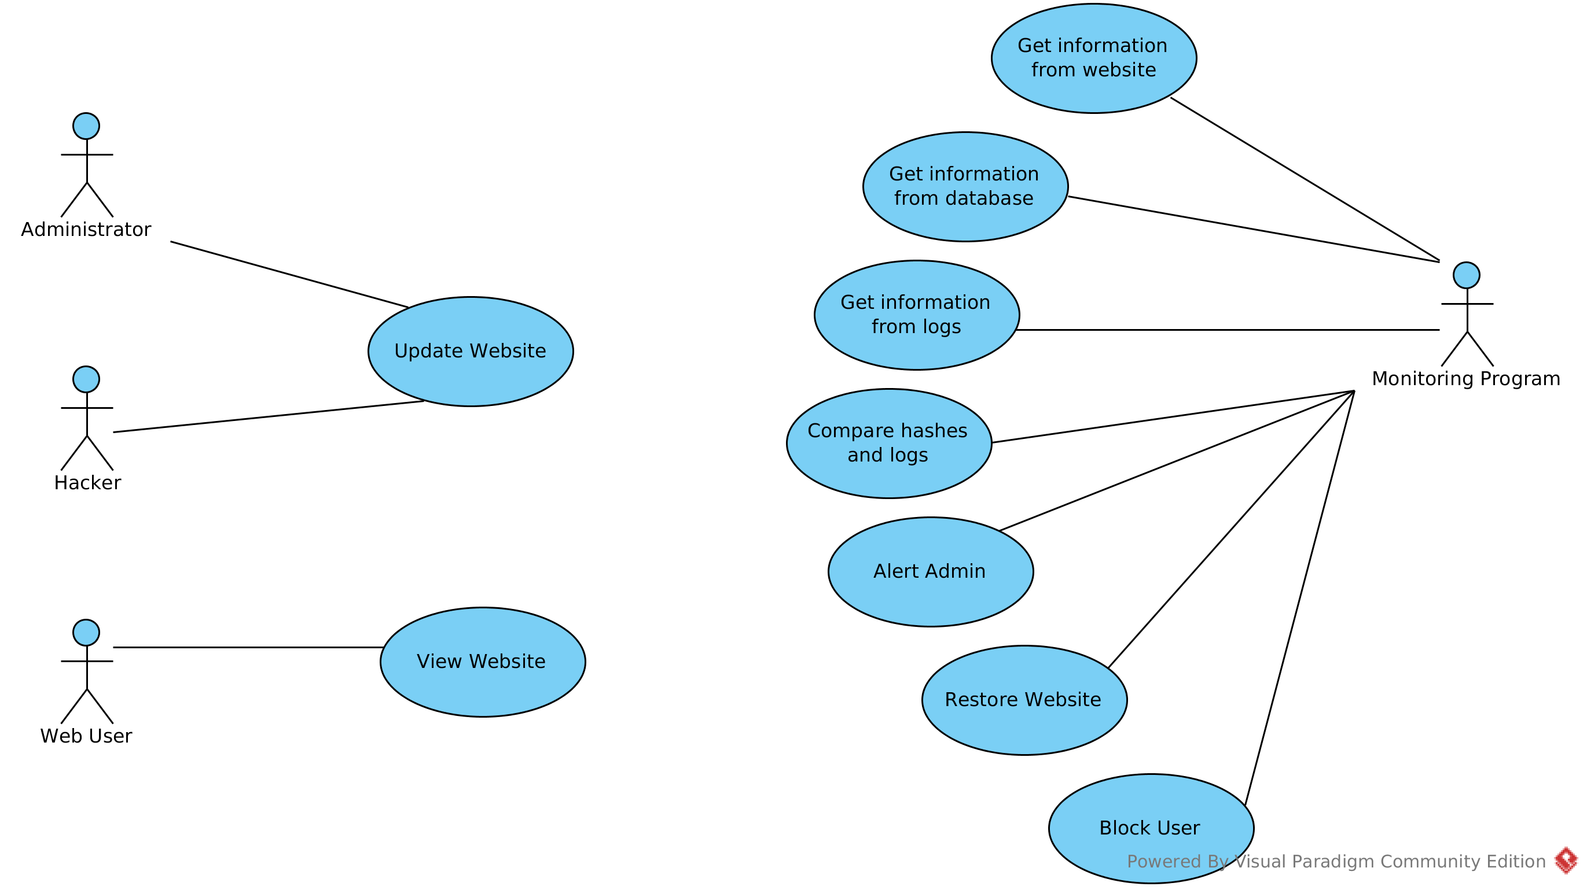
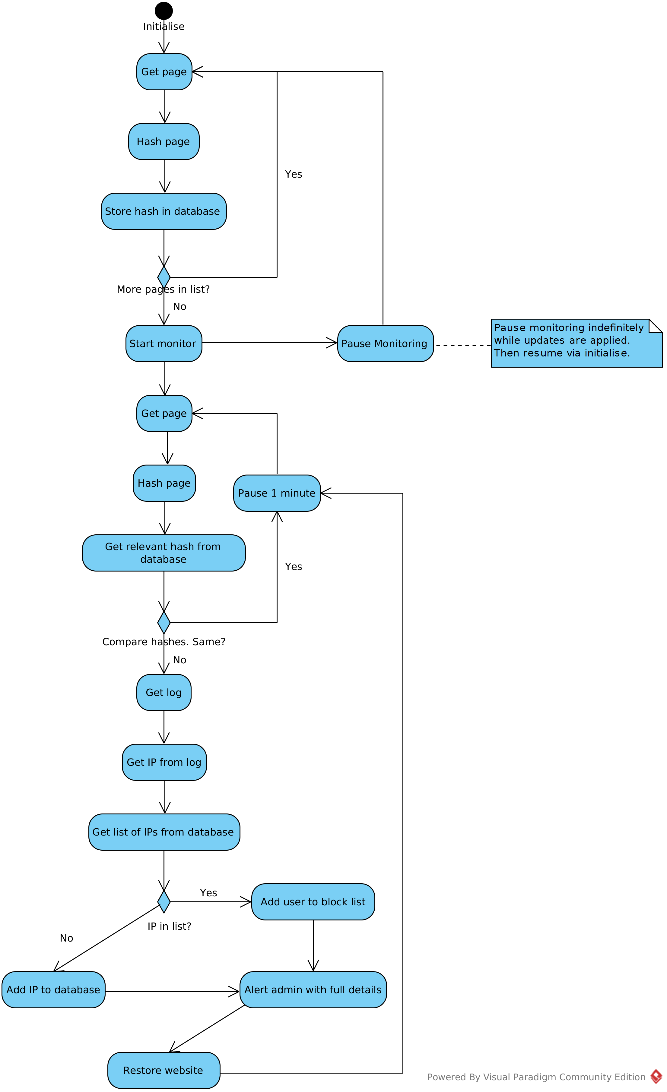
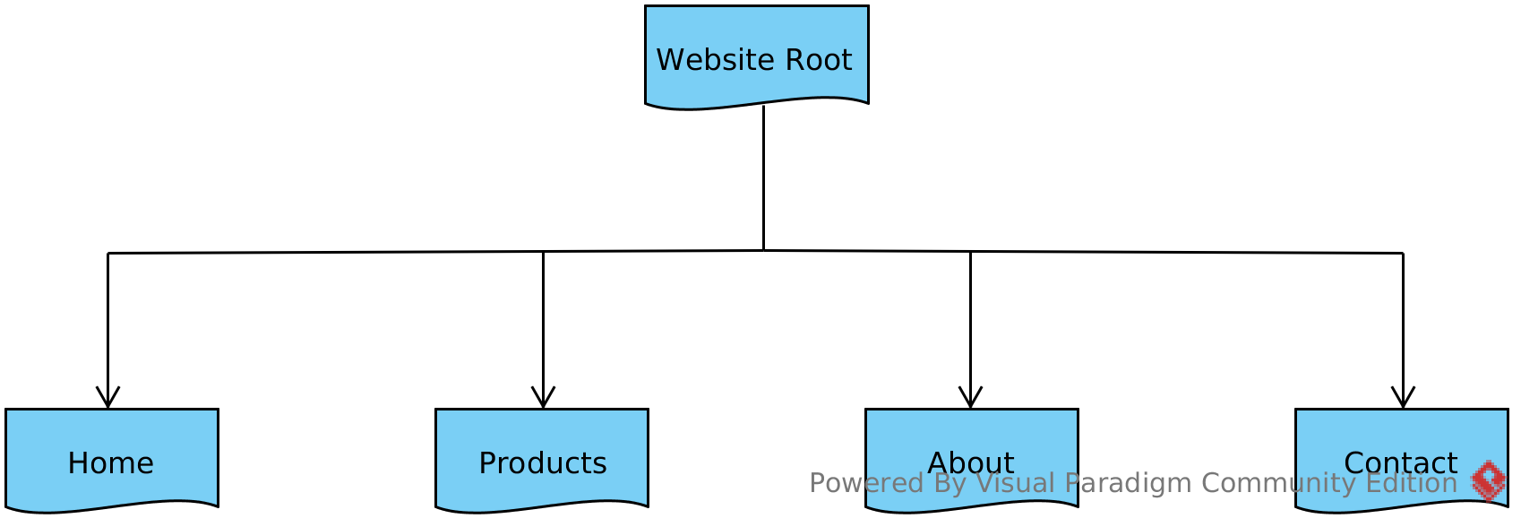
Program design

Slide 7
Program Features
Mainly text based output
Key events emailed to administrator
Lightweight on resources
Minimal input from the user
Continuous monitoring even after an attack
Permanent store of IP addresses and timestamps

Slide 8
How to use the program
Input list of pages into the database
Start running once your website is complete
Stop the program then restart after intentionally changing your website

Slide 9
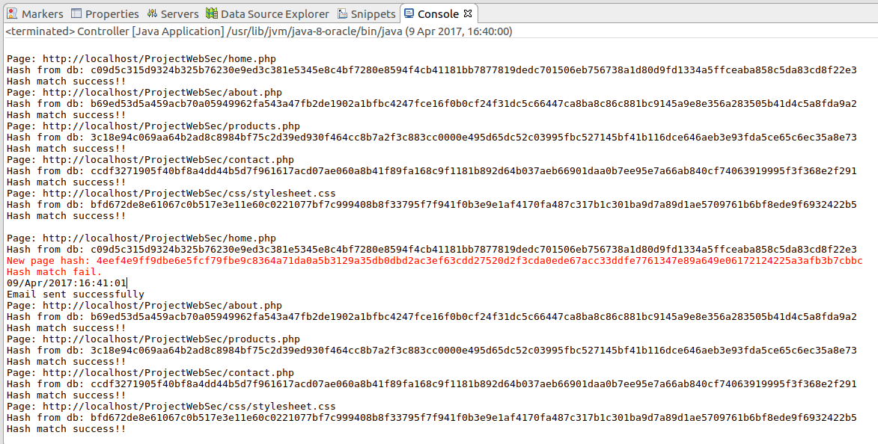
Page monitoring

Slide 10
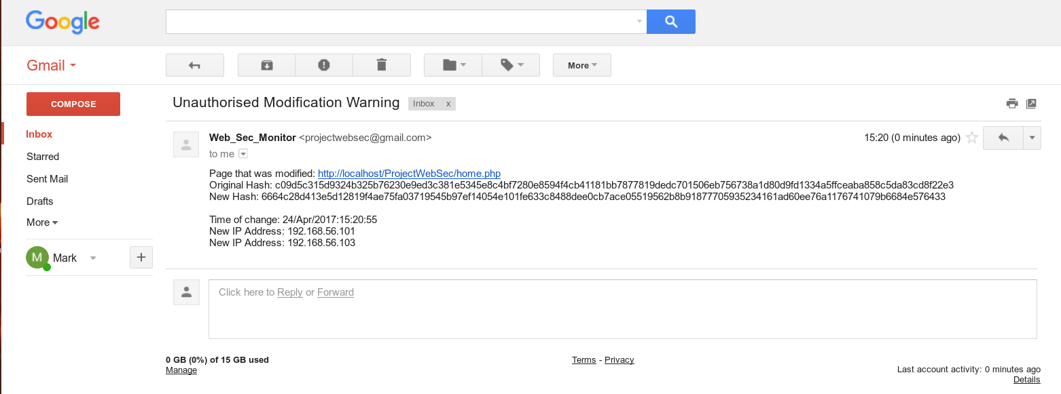
Notifying the administrator

Slide 11
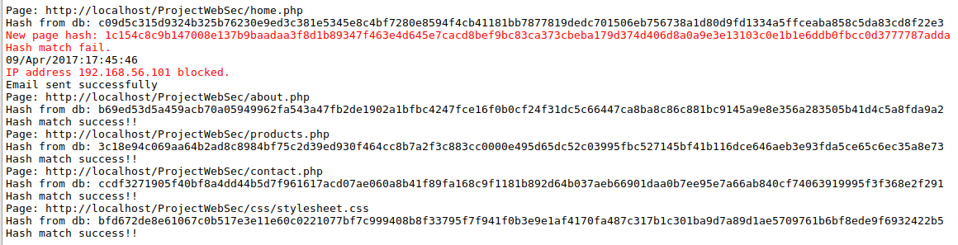
Identifying a hacker’s IP address

Slide 12
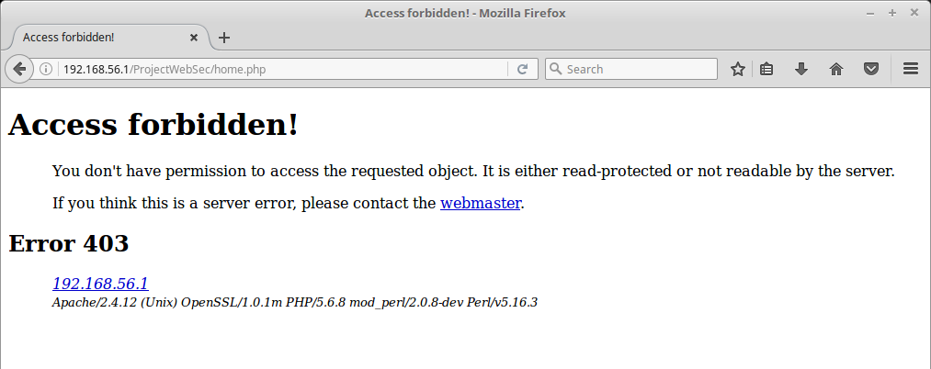
Blocking the hacker

Slide 13
What the program does well
Identifying when web pages have been modified
Identifying who was using the website at that time
Alerting the administrator
Restoring the website

Slide 14
What it can’t do
Block users who access via SSH etc.
Cope with DDOS attack
Identify an attacker who is using the host machine

Slide 15
Demonstration

Slide 16
Any Questions?

